Slide 1


Slide 2
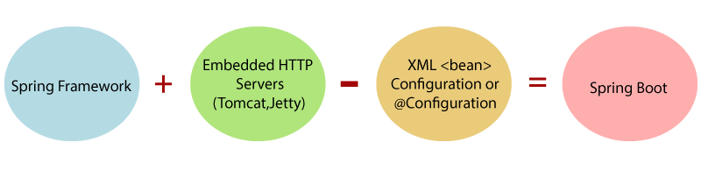
Introduction
What is Spring Boot ?
Spring Boot provides a good platform for Java Developers to develop a stand-alone and production-grade spring application that you can just run.
We can get started with minimum configurations without the need for an entire spring configuration set up.

Slide 3
Advantages
Easy to understand and develop spring applications
Increase productivity
Reduces the development time
There is no requirement of XML configuration in spring

Slide 4
Spring Boot Features
Web Development
Admin features
Externalized Configuration
Properties Files
YAML Support
Logging
Security

Slide 5
Spring vs Spring Boot
Spring | Spring Boot
Spring Framework is a widely used Java EE framework for building applications. | Spring Boot Framework is widely used to develop REST APIs.
The primary feature of the Spring Framework is dependency injection. | The primary feature of Spring Boot is Autoconfiguration. It automatically configures the classes based on the requirement.
It helps to make things simpler by allowing us to develop loosely coupled applications. | It helps to create a stand-alone application with less configuration.
To test the Spring project, we need to set up the sever explicitly. | Spring Boot offers embedded server such as Jetty and Tomcat, etc.
It does not provide support for an in-memory database. | It offers several plugins for working with an embedded and in-memory database such as H2.
Developers manually define dependencies for the Spring project in pom.xml. | Spring Boot comes with the concept of starter in pom.xml file that internally takes care of downloading the dependencies JARs based on Spring Boot Requirement.

Slide 6
Spring MVC vs Spring Boot
Spring Boot | Spring MVC
Spring Boot is a framework to develop REST APIs. It is used to build stand-alone web spring applications. | Spring MVC is a Model, View, and Controller based framework used to build web applications.
It provides default configurations to build Spring-powered framework | It provides ready to use features for building a web application.
There is no need to build configuration manually. | It requires build configuration manually.
There is no requirement for a deployment descriptor. | A Deployment descriptor is required.
It reduces development time and increases productivity. | It takes more time to achieve the same

Slide 7
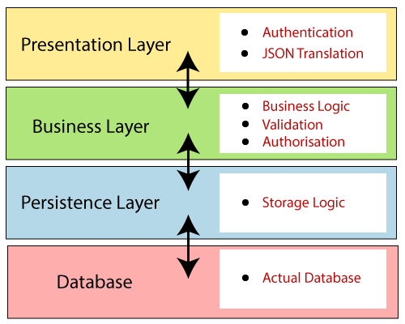
Spring Boot Architecture
Spring Boot follows a layered architecture in which each layer communicates with the layer directly.

Slide 8
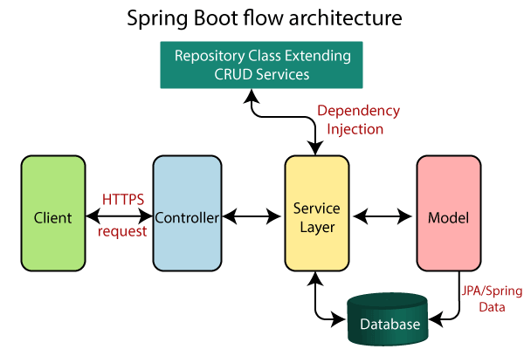
Spring Boot Flow Architecture

Slide 9
Ways to Create Spring Boot Project
Spring initializer. (https://start.spring.io/)
STS eclipse plugin
Create a Maven project manually and add all the required dependencies for spring boot starter.

Slide 10
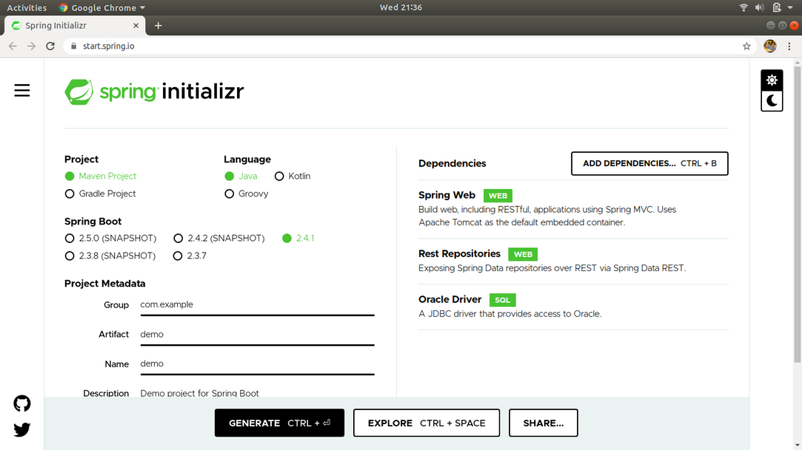
1. Creating Spring Boot Project with Spring Initializer

Slide 11
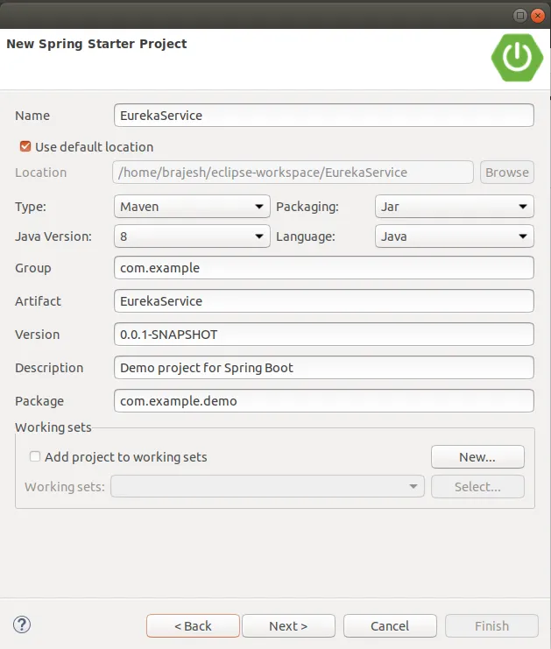
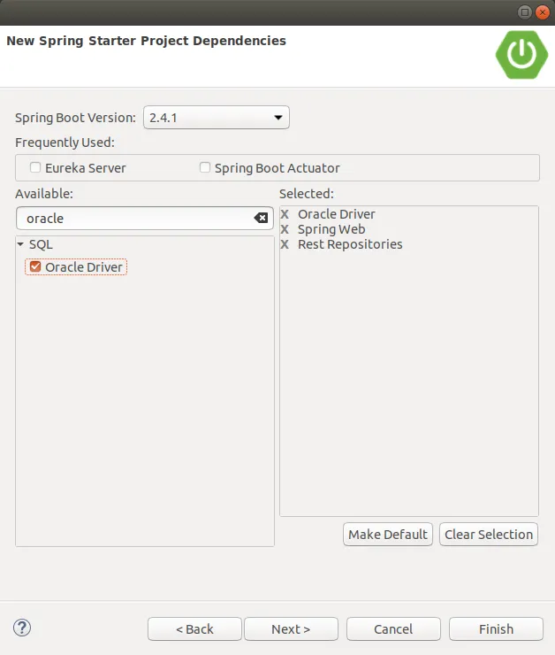
2. Creating Spring Boot Project with STS Eclipse Plugin

Slide 12
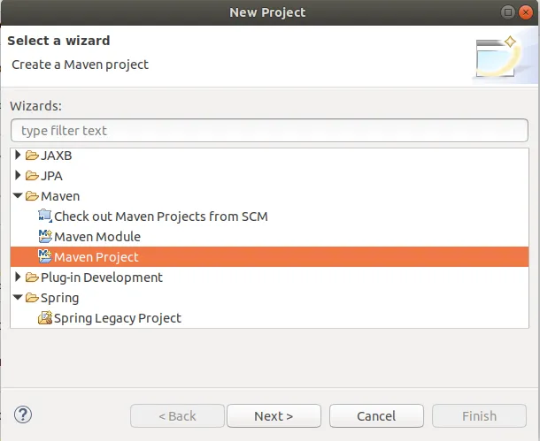
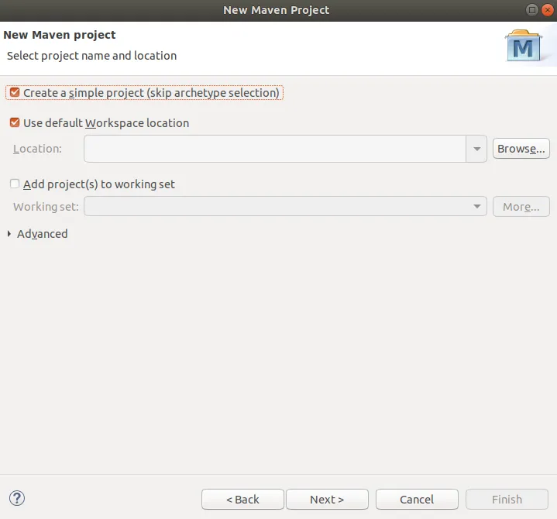
3. Creating a maven project Manually

Slide 13
Code Sample
package com.java;
import org.springframework.boot.SpringApplication;
import org.springframework.boot.autoconfigure.SpringBootApplication;
@SpringBootApplication
public class SpringBootHelloWorldExampleApplication
{
public static void main(String[] args)
{
SpringApplication.run(SpringBootHelloWorldExampleApplication.class, args);
}
}

Slide 14
Annotation
@SpringBootApplication
A single @SpringBootApplication annotation is used to enable the following annotations:
@EnableAutoConfiguration
@ComponentScan
@Configuration

Slide 15
Core Spring Framework Annotations
@Required
@Autowired
@Configuration
@Bean

Slide 16
Spring Framework Stereotype Annotations
@Component
@Controller
@Service
@Repository

Slide 17
Rest Annotations
@RequestMapping
@GetMapping: @RequestMapping(method = RequestMethod.GET)
@PostMapping: @RequestMapping(method = RequestMethod.POST)
@PutMapping: @RequestMapping(method = RequestMethod.PUT)
@DeleteMapping: @RequestMapping(method = RequestMethod.DELETE)
@PathVariable
@RestController

Slide 18
Spring Boot Main Components
Four Main Components:
Spring Boot Starters - Combine a group of common or related dependencies into single dependency
Spring Boot AutoConfigurator - Reduce the spring configuration
Spring Boot CLI - Run and test spring boot applications from command prompt
Spring Boot Actuator - Provides Endpoints and metrics

Slide 19
Spring Boot Starters
Spring Boot provides a number of starters that allow us to add jars in the classpath. Spring Boot built-in starters make development easier and rapid.
Spring Boot Starters are the dependency descriptors.
In the Spring Boot Framework, all the starters follow a similar naming pattern: spring-boot-starter-*, where * denotes a particular type of application.
Example
spring-boot-starter-web-services : It is used for Spring Web Services.
spring-boot-starter-web : It is used for building the web application, including RESTful applications using Spring MVC. It uses Tomcat as the default embedded container.

Slide 20
Spring Boot Starter Parent
<parent>
<groupId>org.springframework.boot</groupId>
<artifactId>spring-boot-starter-parent</artifactId>
<version>1.4.0.RELEASE</version>
</parent>
Parent Poms allow us to manage the following things for multiple child projects and modules:
Configuration: It allows us to maintain consistency of Java Version and other related properties.
Dependency Management: It controls the versions of dependencies to avoid conflict.
Source encoding
Default Java Version
It also controls the default plugin configuration.

Slide 21
Spring Boot Starter Web
Starter of Spring web uses Spring MVC, REST and Tomcat as a default embedded server.
Pom.xml
<dependency>
<groupId>org.springframework.boot</groupId>
<artifactId>spring-boot-starter-web</artifactId>
<version>2.2.2.RELEASE</version>
</dependency>
Features :
It is compatible for web development
Auto configuration

Slide 22
Spring Data JPA
Spring Data JPA handles most of the complexity of JDBC-based database access and ORM (Object Relational Mapping).
It makes the implementation of your persistence layer easier and faster.
Example
public interface EmployeeRepository extends CrudRepository<Employee, Long>
{
Employee findByName(String name);
}

Slide 23
Spring Data Repository
Spring Data JPA provides three repositories are as follows:
CrudRepository
PagingAndSortingRepository
JpaRepository
Pom.xml
<dependency>
<groupId>org.springframework.data</groupId>
<artifactId>spring-data-jpa</artifactId>
<version>2.2.3.RELEASE</version>
</dependency>

Slide 24
Spring Boot Starter Data JPA
Spring Boot provides spring-boot-starter-data-jpa dependency to connect Spring application with relational database efficiently. The spring-boot-starter-data-jpa internally uses the spring-boot-jpa dependency.
Pom.xml
<dependency>
<groupId>org.springframework.boot</groupId>
<artifactId>spring-boot-starter-data-jpa</artifactId>
<version>2.2.2.RELEASE</version>
</dependency>

Slide 25
Spring Boot Starter Test
The spring-boot-starter-test is the primary dependency for the test. It contains the majority of elements required for our tests.
Pom.xml
<dependency>
<groupId>org.springframework.boot</groupId>
<artifactId>spring-boot-starter-test</artifactId>
<version>2.2.2.RELEASE</version>
<scope>test</scope>
</dependency>

Slide 26
Spring Boot DevTools
DevTools stands for Developer Tool. The aim of the module is to try and improve the development time while working with the Spring Boot application. Spring Boot DevTools pick up the changes and restart the application.
Pom.xml
<dependency>
<groupId>org.springframework.boot</groupId>
<artifactId>spring-boot-devtools</artifactId>
<scope>runtime<scope >
</dependency>

Slide 27
Spring Boot DevTools Features
Spring Boot DevTools provides the following features:
Automatic Restart
LiveReload
Remote Update and Restart

Slide 28
Thank You

